Slide 1
Introduction to HTML

Slide 2
Agenda
Definitions
Introduction
Different HTML elements

Slide 3
Images

Slide 4
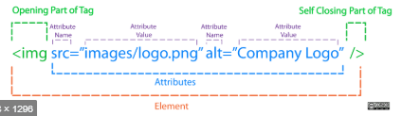
Images
a picture can say a thousand words, and great images help make the difference between an average-looking site and a really engaging one.
<img>this element defines a graphic image on the page.
image file (src:source): this value will be a url (location of the image) e.g. http://www.apiit/images/myiamge.jpg
alternate text (alt): this is a text field that describes an image or acts as a label. it is displayed when they position the cursor over a graphic image.
alignment (align): this allows you to align the image

Slide 5
Images - more attributes
width (width): is the width of the image in pixels.
height (height): is the height of the image in pixels.
border (border): is for a border around the image, specified in pixels.
hspace: is for horizontal space on both sides of the image specified in pixels. a setting of 5 will put 5 pixels of invisible space on both sides of the image.
vspace: is for vertical space on top and bottom of the image specified in pixels. a setting of 5 will put 5 pixels of invisible space above and bellow the image.

Slide 6

Some Examples on images
1) <img src=“myapiit.gif“ border=4>
2) <img src="myapiit.gif " width="60" height="60">
3) <img src=" myapiit.gif “ hspace="30" vspace="10" border=20>
4) < img src =" myapiit.gif“ align="left">

Slide 7
Tools to Edit & Save Images
The most popular tool amongst web professionals is Adobe Photoshop. (In fact, professional web designers often use this software to design entire sites.)
The full version of Photoshop is expensive, but there is a cheaper version called Photoshop Elements which would suit the needs of most beginners
Adobe Fireworks
Pixelmator
PaintShop Pro
Paint.net
Online Editors
www.photoshop.com
www.pixlr.com
www.splashup.com
www.ipiccy.com

Slide 8


Image Formats
JPEG - Whenever you have many different colors in a picture you should use a JPEG. A photograph that features details with bright colours. – photographic images
Use GIF or PNG format when saving images with few colors or large areas of the same color. - Logos, illustrations, and diagrams

Slide 9
Resolution
JPGs, GIFs, and PNGs belong to a type of image format known as bitmap. They are made up of lots of miniature squares. The resolution of an image is the number of squares that fit within a 1 inch x 1 inch square area.
Images appearing on computer screens are made of tiny squares called pixels
The web browsers on most desktop computers display images at a resolution of 72 pixels per inch (ppi). Images in print materials (such as books and magazines) are made up of tiny circles called dots. These images are usually printed at a resolution of 300 dots per inch (dpi).
Due to the fact that computer displays are capped at a resolution of 72 ppi, using images on the web with a higher resolution will not result in better image quality — only will increase the time needed to load them

Slide 10
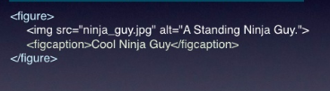

HTML 5: Figure and Figure Caption

Slide 11
Anchors, URLs and Image Maps

Slide 12
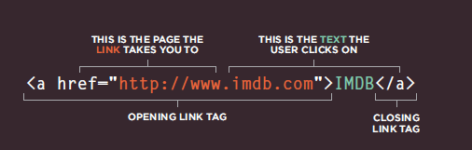
HOW TO MAKE A LINK
The tags used to produce links are the <A> and </A>.
The <A> tells where the link should start and the </A> indicates where the link ends.
Everything between these two will work as a link.
The example below shows how to make the word
Here work as a link to yahoo.
Click <A HREF="http://www.yahoo.com">here</A> to go to yahoo.

Slide 13
Links
<a> - Links are created using the <a> element which has an attribute called href. The value of the href attribute is the page that you want people to go to when they click on the link.
The value of the href attribute will be the full web address for the site, which is known as an absolute URL.
This can be used to even link different web pages in the same web application.

Slide 14
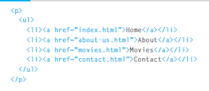

E.g.:

Slide 15
LInks
<body LINK="#C0C0C0" VLINK="#808080" ALINK="#FF0000">
LINK - standard link - to a page the visitor hasn't been to yet. (standard color is blue - #0000FF). VLINK - visited link - to a page the visitor has been to before. (standard color is purple - #800080). ALINK - active link - the color of the link when the mouse is on it. (standard color is red - #FF0000).
If the programmer what to change the color
Click <a href="http://www.yahoo.com"><font color="FF00CC">here</font></a> to go to yahoo.

Slide 16
Opening Links in a New Window
<target> tag
<a href="http://www.imdb.com" target="_blank"> Internet Movie Database</a> (opens in new window)

Slide 17
Internal Links
Internal Links : Links can also be created inside large documents to simplify navigation. Today’s world wants to be able to get the information quickly. Internal links can help you meet these goals.
<a href=“#bookmark_name”>Go To Book Mark</a>
Make sure you have already create an Id attribute for the content you need to link.
<h1 id=“bookmark_name”> The Content </h1>

Slide 18
E-Mail (Electronic Mail)
E.g. mailto:kmf@yahoo.com
The type of service is identified as the mail client program. This type of link will launch the users mail client.
The recipient of the message is kmf@yahoo.com
<A HREF=“mailto:kmf@yahoo.com”>Send me
More Information </A>

Slide 19
Tables

Slide 20
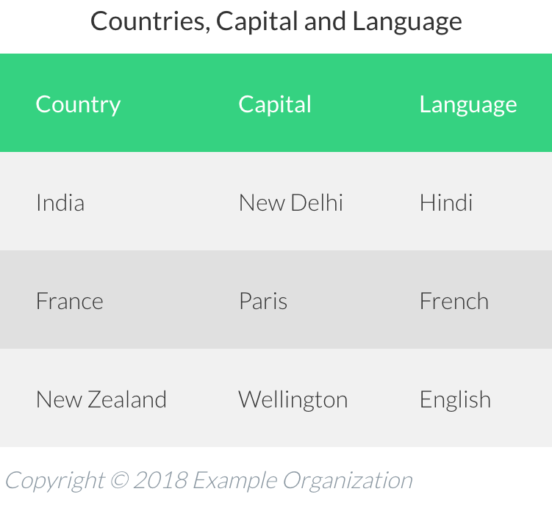
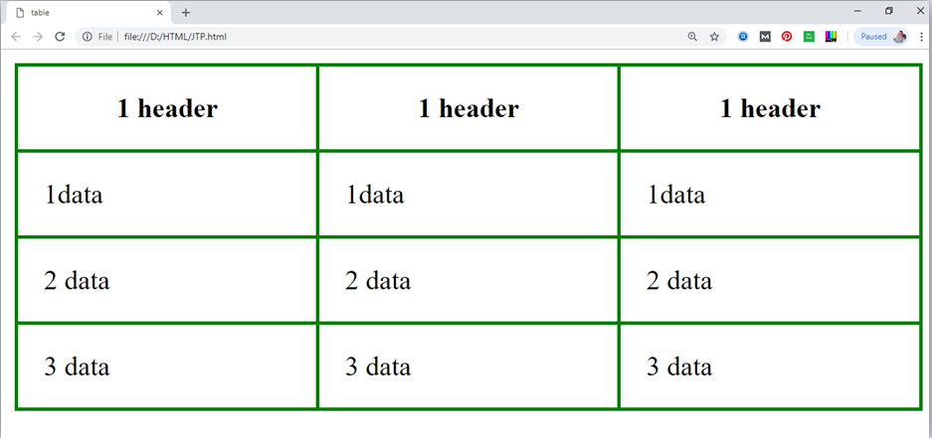
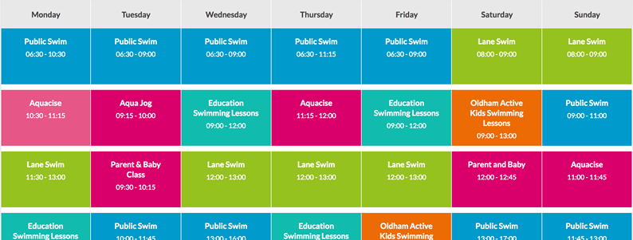
Tables

Slide 21
tables
The <TABLE></TABLE> element is used to declare a table: it has few sub elements.
Table Row<TR></TR>.
Table Header <TH></TH>.
Table Data <TD></TD>.
Caption <CAPTION></CAPTION>.
The table row elements usually contain table header elements or table data elements.

Slide 22
Tables
<table border=“1”>
<tr>
<th> Column 1 header </th>
<th> Column 2 header </th>
</tr>
<tr>
<td> Row1, Col1 </td>
<td> Row1, Col2 </td>
</tr>
<tr>
<td> Row2, Col1 </td>
<td> Row2, Col2 </td>
</tr>
</table>
Column 1 Header | Column 2 Header
Row1, Col1 | Row1, Col2
Row2, Col1 | Row2, Col2

Slide 23
Tables Attributes
BGColor: Some browsers support background colors in a table.
Width: you can specify the table width as an absolute number of pixels or a percentage of the document width. You can set the width for the table cells as well.
Border: You can choose a numerical value for the border width, which specifies the border in pixels.
CellSpacing: Cell Spacing represents the space between cells and is specified in pixels.

Slide 24
Tables Attributes
CellPadding: Cell Padding is the space between the cell border and the cell contents and is specified in pixels.
Align: tables can have left, right, or center alignment.
Background: Background Image, will be titled in IE3.0 and above.
BorderColor, BorderColorDark.

Slide 25
Table Caption
A table caption allows you to specify a line of text that will appear centered above or bellow the table.
<TABLE BORDER=1 CELLPADDING=2>
<CAPTION ALIGN=“BOTTOM”> Label For My Table </CAPTION>
The Caption element has one attribute ALIGN that can be either TOP (Above the table) or BOTTOM (below the table).

Slide 26
Table Header
Table Data cells are represented by the TD element. Cells can also be TH (Table Header) elements which results in the contents of the table header cells appearing centered and in bold text.

Slide 27
Table Data and Table Header Attributes - Extra
Colspan: Specifies how many cell columns of the table this cell should span.
Rowspan: Specifies how many cell rows of the table this cell should span.
Align: cell data can have left, right, or center alignment.
Valign: cell data can have top, middle, or bottom alignment.
Width: you can specify the width as an absolute number of pixels or a percentage of the document width.
Height: You can specify the height as an absolute number of pixels or a percentage of the document height.

Slide 28
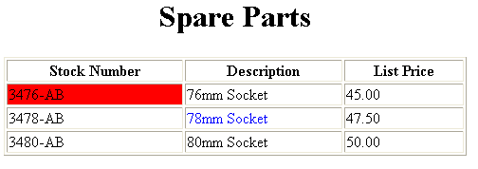
Example
<table border=1 width=50%>
<caption> <h1>spare parts <h1> </caption>
<tr>
<th>stocknumber</th>
<th>description</th>
<th>list price</th>
</tr>
<tr>
<td bgcolor=red>3476-ab</td>
<td>76mm socket</td>
<td>45.00</td>
</tr>
<tr>
<td >3478-ab</td>
<td><font color=blue>78mm socket</font> </td>
<td>47.50</td>
</tr>
<tr><td>3480-ab</td><td>80mm socket</td><td>50.00</td></tr>
</table>

Slide 29
Another Example
<Table border=1 cellpadding =2>
<tr> <th> Column 1 Header</th> <th> Column 2 Header</th> </tr>
<tr> <td colspan=2> Row 1 Col 1</td> </tr>
<tr> <td rowspan=2>Row 2 Col 1</td>
<td> Row 2 Col2</td> </tr>
<tr> <td> Row 3 Col2</td> </tr>
</table>

Slide 30
Table Data and Table Header Attributes
Column 1 Header | Column 2 Header
Row 1 Col 1
Row 2 Col 1 | Row 2 Col 2
 | Row 3 Col 2

Slide 31
Notes
TH, TD and TR should always have end tags. Although the end tags are formally optional, many browsers will mess up the formatting of the table if you omit the end tags. In particular, you should always use end tags if you have a TABLE within a TABLE -- in this situation, the table parser gets hopelessly confused if you don't close your TH, TD and TR elements.
A default TABLE has no borders By default, tables are drawn without border lines. You need the BORDER attribute to draw the lines.
By default, a table is flush with the left margin TABLEs are plopped over on the left margin. If you want centered tables, You can either: place the table inside a DIV element with attribute ALIGN="center". Most current browsers also supports table alignment, using the ALIGN attribute. Allowed values are "left", "right", or "center", for example: <TABLE ALIGN="left">. The values "left" and "right" float the table to the left or right of the page, with text flow allowed around the table. This is entirely equivalent to IMG alignment

Slide 32
HTML 5 - tables
There are three elements that help distinguish between the main content of the table and the first and last rows (which can contain different content).
These elements help people who use screen readers and also allow you to style these sections in a different manner than the rest of the table (as you will see when you learn about CSS). <thead>
The headings of the table should sit inside the <thead> element.
The body should sit inside the <tbody> element.
The footer belongs inside the <tfoot> element.

Slide 33
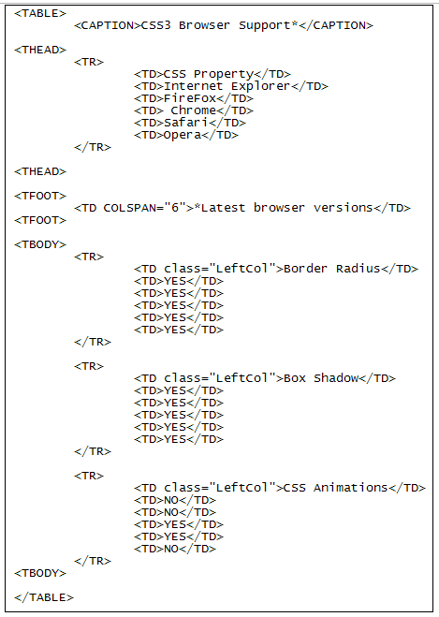
Example
Image taken from : https://www.homeandlearn.co.uk/WD/wds7p4.html

Slide 34
Forms

Slide 35
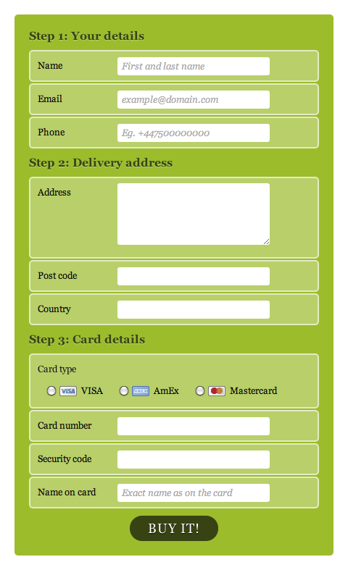
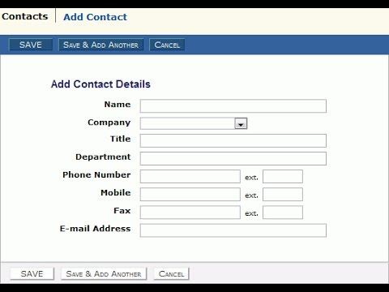
Forms
HTML borrows the concept of a form to refer to different elements that allow you to collect information from visitors to your site.

Slide 36
FORMS
To insert a form we use the <FORM></FORM> tags. The rest of the form elements must be inserted in between the form tags.
<!DOCTYPE html>
<html>
<head>
<title> sample form</title>
</head>
<body bgcolor=“ffffff”>
<form>
first name: <input type=“text” name=“fname” maxlength=“50”>
<input type=“submit” name=“fsubmit1” value=“send info”>
</form>
</body>
</html>

Slide 37
Form element
<form action=http://www.example.com/subscribe.php method="get">
<p>This is where the form controls will appear. </p>
</form>
ACTION: is the URL of the program that is going to accept the data from the form, process it, and send a response back to the browser. METHOD: GET (default) or POST specifies which HTTP method will be used to send the form’s contents to the web server. The CGI application should be written to accept the data from either method.
We do not need to worry about that very much. We will look into this when we learn serve side technology.

Slide 38
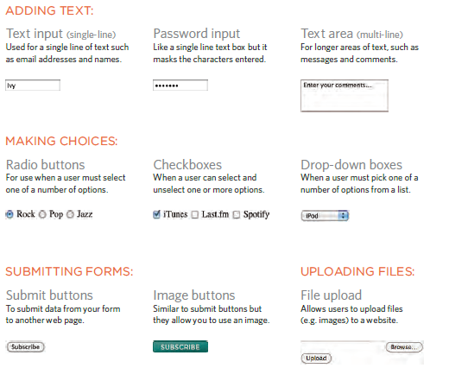
Form controls
Forms have lot of control elements : Text boxes, Password boxes, Checkboxes, Option(Radio) buttons, Submit, Reset, File, Hidden and Image.
The properties are specified in the TYPE Attribute of the HTML element <INPUT></INPUT>.

Slide 39
Form input elements properties
<INPUT> Element’s Properties
TYPE= Type of INPUT entry field.
NAME = Variable name passed to CGI application
VALUE= The data associated with the variable name to be passed to the CGI application
CHECKED= Button/box checked
SIZE= Number of visible characters in text field
MAXLENGHT= Maximum number of characters accepted.

Slide 40

Text Box
Text boxes: Used to provide input fields for text, phone numbers, dates, etc.
<INPUT TYPE= " TEXT " >
Browser will display
Textboxes use the following attributes:
TYPE: text.
SIZE: determines the size of the textbox in characters. Default=20 characters.
MAXLENGHT : determines the maximum number of characters that the field will accept.
NAME: is the name of the variable to be sent to the CGI application.
VALUE: will display its contents as the default value.

Slide 41
Example on Text Box
<TITLE>Form_Text_Type</TITLE>
</HEAD> <BODY>
<h1> <font color=blue>Please enter the following bioData</font></h1>
<form >
first name: <input type="text" name="fname"
size="15" maxlength="25"><br>
last name: <input type="text" name="lname"
size="15" maxlength="25"><br>
nationality: <input type="text" name="country"
size="25" maxlength="25"><br>
the phone number: <input type="text" name="phone"
size="15" maxlength="12"><br>
</form> </body> </html>

Slide 42
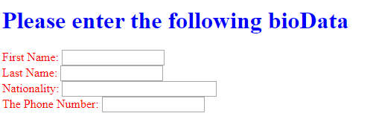
Output

Slide 43
Password field
Password: Used to allow entry of passwords.
<INPUT TYPE= " PASSWORD " >
Browser will display
Text typed in a password box is starred out in the browser
display.
Password boxes use the following attributes:
TYPE: password.
SIZE: determines the size of the textbox in characters.
MAXLENGHT: determines the maximum size of the password in characters.
NAME: is the name of the variable to be sent to the CGI application.
VALUE: is usually blank.

Slide 44
Example on Password Box
<HTML><HEAD>
<TITLE>Form_Password_Type</TITLE></HEAD>
<BODY>
<h1> <font color=red>To Access, Please
enter:</font></h1>
<FORM name="fome2" Action="url" method="get">
User Name: <INPUT TYPE="TEXT" Name="FName"
SIZE="15" MAXLENGTH="25"><BR>
Password: <INPUT TYPE="PASSWORD"
NAME="PWord" value="" SIZE="15”
MAXLENGTH="25"><BR>
</FORM></BODY> </HTML>

Slide 45
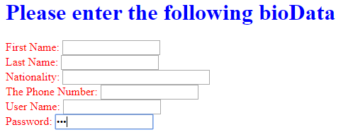
Activity
Update the pervious form by adding a username and password fields

Slide 46
Check box
Check Box: Check boxes allow the users to select more than one option.
<INPUT TYPE=“CHECKBOX”>
Browser will display
Checkboxes have the following attributes:
TYPE: checkbox.
CHECKED: is blank or CHECKED as the initial
status.
NAME: is the name of the variable to be sent to the
CGI application.
VALUE: is usually set to a value.

Slide 47
<html> <head><title>checkboxtype</title> </head>
<body>
<h1> <font color=green>please check one of the following</font></h1>
<form name="fome3" action="url" method="get">
<font color=red> select country: </font><br>
jordan:<input type="checkbox" name="country" checked><br>
yemen<input type="checkbox" name="country"><br>
qatar:<input type="checkbox" name="country"><br> <br>
<font color=blue>select language:</font><br>
arabic:<input type="checkbox" name="language" checked><br> english:<input type="checkbox" name="language"><br>
french:<input type="checkbox" name="language"> <br></form> </body></html>

Slide 48
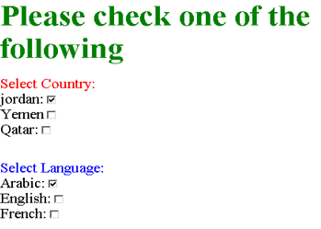
output

Slide 49
Radio button
Radio Button: Radio buttons allow the users to select
only one option.
<INPUT TYPE=“RADIO”>
Browser will display
Radio buttons have the following attributes:
TYPE: radio.
CHECKED: is blank or CHECKED as the initial
status. Only one radio button can be
checked
NAME: is the name of the variable to be sent to the
CGI application.
VALUE: usually has a set value.

Slide 50
<html> <head><title>checkboxtype</title> </head>
<body>
<h1> <font color=green>please check one of the following</font></h1>
<form name="fome3" action="url" method="get">
<font color=red> select country: </font><br>
jordan:<input type= "radio" name="country" checked><br>
yemen<input type="radio" name="country"><br>
qatar:<input type="radio" name="country"><br> <br>
<font color=blue>select language:</font><br>
arabic:<input type="radio" name="language" checked><br> english:<input type=" radio " name="language"><br>
french:<input type=" radio " name="language"> <br></form> </body></html>

Slide 51
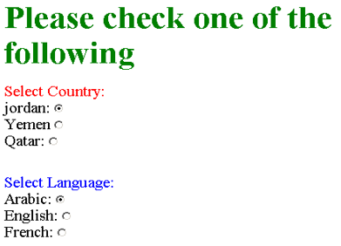
output

Slide 52
Button
Push Button: This element would be used with
JavaScript to cause an action to take place.
<INPUT TYPE=“BUTTON”>
Browser will display
Push Button has the following attributes:
TYPE: button.
NAME: is the name of the button to be used
in scripting.
VALUE: determines the text label on the button.

Slide 53
<div align=center><br><br>
<form>
<font color=red>
<h1>press here to see a baby crying:<br>
<input type="button" value="pressme"><br><br>
<font color=blue>
click here to see a baby shouting:<br>
<input type="button" value="clickme" > <br><br>
<font color=green>
hit here to see a baby eating:<br>
<input type="button" value="hitme" > <br><br>
<font color=yellow>
</form></div>

Slide 54
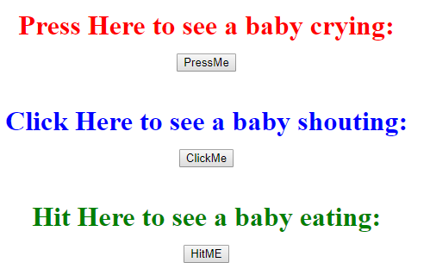
output

Slide 55
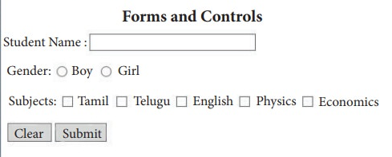
Activity
Develop the below form

Slide 56
Submit
Submit: Every set of Form tags requires a Submit button. This is the element causes the browser to send the names and values of the other elements to the CGI Application specified by the ACTION attribute of the FORM element.
<INPUT TYPE=“SUBMIT”>
The browser will display
Submit has the following attributes:
TYPE: submit.
NAME: value used by the CGI script for processing.
VALUE: determines the text label on the button, usually Submit Query.

Slide 57
<form>
first name: <input type="text" size=25 name="firstname"><br>
family name: <input type="text" size=25 name="lastname"><br>
<br>
<font color=red>
press here to submit the data:<br>
<input type="submit" value="submitdata " >
</form>

Slide 58
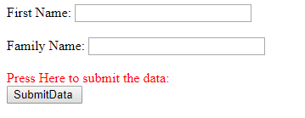
output

Slide 59
Reset
Reset: It is a good idea to include one of these for each form where users are entering data. It allows the surfer to clear all the input in the form.
<INPUT TYPE=“RESET”>
Browser will display
Reset buttons have the following attributes:
TYPE: reset.
VALUE: determines the text label on the button, usually Reset.

Slide 60
<form action="url" method="get">
first name: <input type="text" size=25 name="firstname"> <br>
family name: <input type="text" size=25 name="lastname"><br>
<br>
<font color = red>
<strong><font size=5>press here to submit the data:</font></strong><br>
<input type="submit" value="submitdata">
<input type="reset" value="reset">
</form>

Slide 61
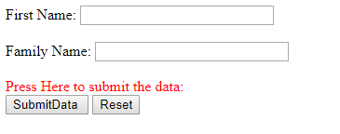
Add a reset button

Slide 62
Image Submit Button
Image Submit Button: Allows you to substitute an image for the standard submit button.
<INPUT TYPE=“IMAGE” SRC=“imagename.gif”>
Image submit button has the following attributes:
TYPE: Image.
NAME: is the name of the button to be used in scripting.
SRC: URL of the Image file.

Slide 63

example
<form>
<H1><font color=“blue”> Click to go APIIT Official web site:
<INPUT TYPE="IMAGE" SRC="1.jpg" width=70 height=70>
</form>

Slide 64

FILE
File Upload: You can use a file upload to allow surfers to upload files to your web server.
<INPUT TYPE=“FILE”>
Browser will display
File Upload has the following attributes:
TYPE: file.
SIZE: is the size of the text box in characters.
NAME: is the name of the variable to be sent to the
CGI application.
MAXLENGHT: is the maximum size of the input in the
textbox in characters.

Slide 65
<BODY bgcolor=lightblue>
<form>
<H3><font color=forestgreen>
Please attach your file here to for uploading to
My <font color =red>SERVER...<BR>
<INPUT TYPE="File" name="myFile" size="30">
<INPUT TYPE="Submit" value="SubmitFile">
</form>
</BODY>

Slide 66
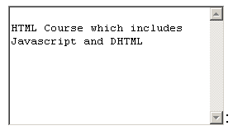
Other Elements – Text area
<TEXTAREA></TEXTAREA>: is an element that allows for free form text entry.
Browser will display
Textarea has the following attributes:
NAME: is the name of the variable to be sent to the CGI application.
ROWS: the number of rows to the textbox.
COLS: the number of columns to the textbox.

Slide 67
<BODY bgcolor=lightblue>
<form>
<TEXTAREA COLS=40 ROWS=20 Name="comments" >
From observing the apathy of those
about me during flag raising I
concluded that patriotism if not
actually on the decline is at least
in a state of dormancy.
Written by Khaled Al-Fagih
</TEXTAREA>:
</form>
</BODY>

Slide 68
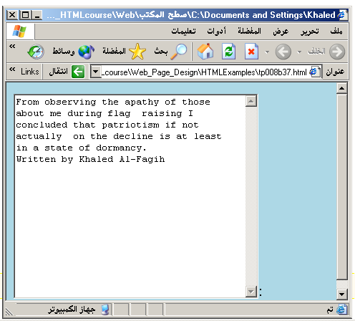

Slide 69
Other Elements – Drop down lists
The two following examples are <SELECT></SELECT> elements, where the attributes are set differently.
The Select elements attributes are:
NAME: is the name of the variable to be sent to the CGI application.
SIZE: this sets the number of visible choices.
MULTIPLE: the presence of this attribute signifies that the user can make multiple selections. By default only one selection is allowed.

Slide 70
<BODY>
<form>
Select the cities you have visited:
<SELECT name=“list” size=5>
<option> London</option>
<option> Tokyo</option>
<option> Paris</option>
<option> New York</option>
<option> LA</option>
<option> KL</option>
</SELECT>
</form>
</BODY>

Slide 71
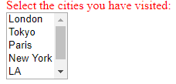
output

Slide 72
Grouping Form Elements
<fieldset> - You can group related form controls together inside this element. This is particularly helpful for longer forms. The appearance of these lines can be adjusted using CSS.
<legend> - The <legend> element can come directly after the opening
<fieldset> tag and contains a caption which helps identify the purpose of that group of form controls

Slide 73
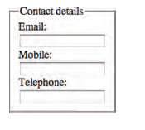
example
<fieldset>
<legend>Contact details</legend>
<label>Email:<br />
<input type="text" name="email" /></label><br />
<label>Mobile:<br />
<input type="text" name="mobile" /></label><br />
<label>Telephone:<br />
<input type="text" name="telephone" /></label>
</fieldset>

Slide 74
HTML Meta Tags
Metadata is information about data.
The <meta> tag provides metadata about the HTML document.
Metadata will not be displayed on the page, but will be machine parsable.
Meta elements are used to show page description, keywords, author of the document, last modified etc.
https://html.spec.whatwg.org/multipage/semantics.html#the-meta-element

Slide 75
What meta tags do we need?
Character setting
<meta charset="utf-8">
Mobile sizes
<meta name=viewport content="width=device-width, initial-scale=1">
For maintenance you need a meta description – this is what the search engine uses
<meta name="description" content="This should describe what the web site is about and contain words people usually search on">

Slide 76
example
<!DOCTYPE html>
<html lang="en">
<head>
<meta charset="utf-8">
<meta name=viewport content="width=device-width, initial-scale=1">
<meta name="description" content="This should describe what the web site is about and contain words people usually search on">
<title>
A standard HTML document
</title>
</head>
Make sure you have meta tags in the assignment index.html too ☺

Slide 77
HTML 5 – form validations
Traditionally, form validation has been performed using JavaScript. But HTML5 is introducing validation and leaving the work to the browser

Slide 78
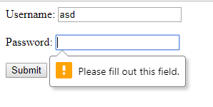
Required field validation
<form>
<label for="username">Username:</label>
<input type="text" name="username" required="required"/><br></br>
<label for="password">Password:</label>
<input type="password" name="password" required="required"/> <br></br>
<input type="submit" value="Submit"/>
</form>

Slide 79
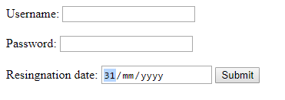
Date validation
<form>
<label for="DD">Resingnation date:</label>
<input type="date" name="depart" />
<input type="submit" value="Submit" />
</form>

Slide 80
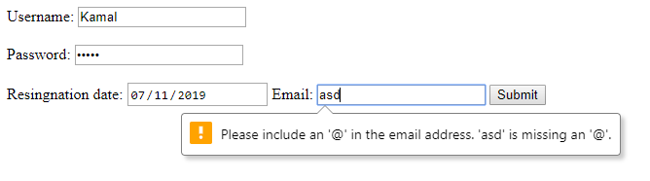
Email Validation
<label for="email"> Email:</label>
<input type="email" name="email" />
<input type="submit" value="Submit" />

Slide 81
Search input
<p>Search:</p>
<input type="search" name="search"
placeholder="Enter keyword" />
<input type="submit" value="Search" />

Slide 82
Other elements – comments, id attribute

Slide 83
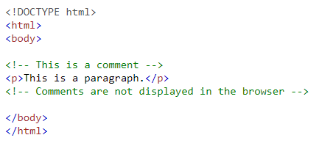
Html comment
<!– this is a comment--> - Anything embedded inside <!-- -- > are considered as a comment and is ignored by the browser when rendering

Slide 84

Id and class attributes
Every HTML element can carry the id attribute. It is used to uniquely identify that element from other elements on the page. Its value should start with a letter or an underscore.
HTML elements can have class attributes too. It is used to uniquely identify a group of elements. (a set)
It is important that no two elements on the same page have the same value for their id and class attributes.
These are used in CSS styling

Slide 85
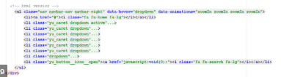
Div element
<div> - in grouping sometime you need to group several classes together. (eg: divide the body into few sections and apply different styles) In such cases you can use div tag.

Slide 86
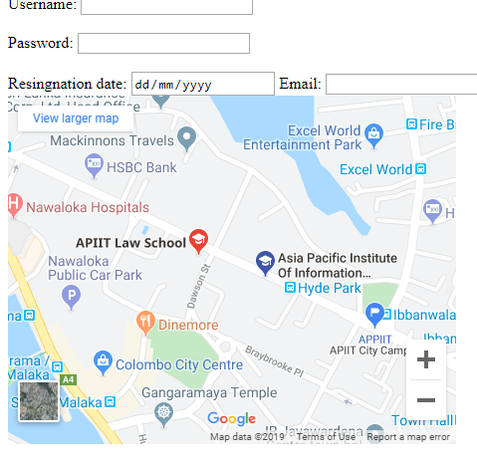
iframe
An iframe is like a little window that has been cut into your page — and in that window you can see another page. The term iframe is an abbreviation of inline frame.
<iframe
src="http://maps.google.co.uk/maps?q=apiit &amp;output=embed"
width="450"
height="350"
frameborder="0"
scrolling="no">
</iframe>

Slide 87
Html5 – adding a video
src - This attribute specifies the path
to the video.
Poster-This attribute allows you to
specify an image to show while
the video is downloading or until
the user tells the video to play.
width, height - specify the size
autoplay
When used, this attribute
specifies that the file should play
automatically.
loop
When used, this attribute
indicates that the video should
start playing again once it has
Ended
controls
When used, this attribute
indicates that the browser
should supply its own controls
for playback.
<body>
<video src="video/puppy.mp4"
poster="images/puppy.jpg"
width="400" height="300"
preload
controls
loop>
Notes:
preload
This attribute tells the browser
what to do when the page
loads. It can have one of three
values:
none
The browser should not load
the video until the user presses
play.
auto
The browser should download
the video when the page loads.
metadata
The browser should just collect
information such as the size,
first frame, track list, and
duration.

Slide 88
Adding an audio
Src- This attribute specifies the path
to the audio file.
Controls- This attribute indicates whether
the player should display
controls. If you do not use this
attribute, no controls will be
shown by default. You can also
specify your own controls using
JavaScript.
autoplay
The presence of this attribute
indicates that the audio should
start playing automatically.
preload
This attribute indicates what the
browser should do if the player is
not set to autoplay. It can have
the same values as <video> element.
loop
This attribute specifies that the
audio track should play again
once it has finished.
<body>
<audio src="audio/test-audio.ogg"
controls autoplay>
<p>Our audio
format.</p>
</audio>
</body>

Slide 89
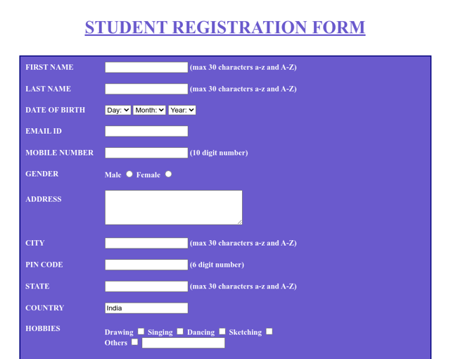
Activity
Create a registration page for a university degree enrolment. Use all the controls we learnt.

Slide 90
Summary
Introduction to HTML
HTML elements
Some HTML 5 elements

